Slide 1

Introduction to Cloud Computing
Dr.U.Seshadri

Slide 2
What is Cloud Computing?
Cloud Computing is defined as storing and accessing of data and computing services over the internet. It doesn’t store any data on your personal computer. It is the on-demand availability of computer services like servers, data storage, networking, databases, etc.
The main purpose of cloud computing is to give access to data centers to many users. Users can also access data from a remote server.
Examples of Cloud Computing Services: AWS, Azure, Google Cloud

Slide 3
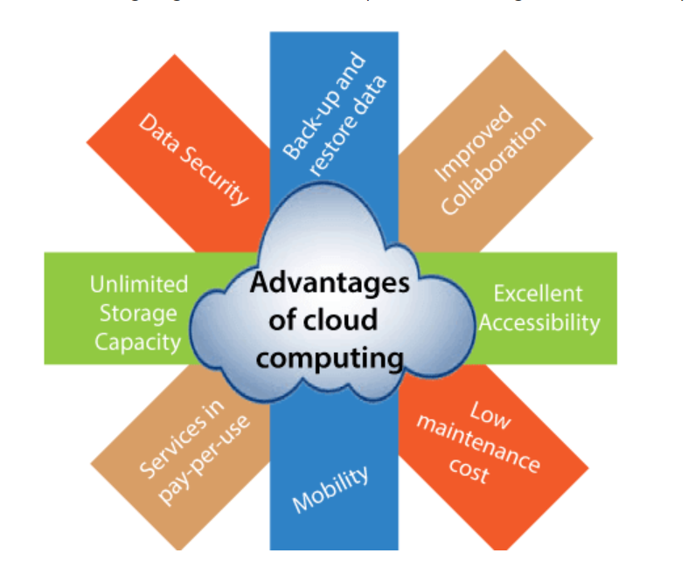
Advantages of Cloud Computing

Slide 4

Cloud Deployment Models

Slide 5
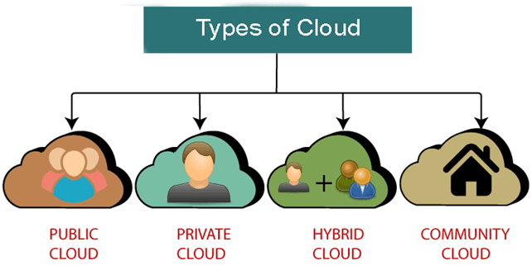
Cloud Deployment Models
There are the following 4 types of cloud that you can deploy according to the organization's needs-

Slide 6
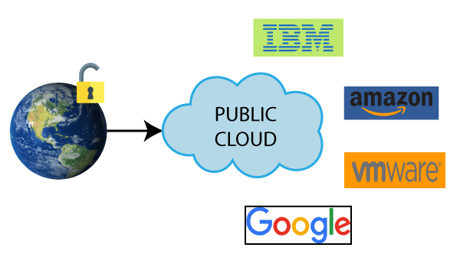
Public cloud is open to all to store and access information via the Internet using the pay-per-usage method.
In public cloud, computing resources are managed and operated by the Cloud Service Provider (CSP).
Example: Amazon elastic compute cloud (EC2), IBM SmartCloud Enterprise, Microsoft, Google App Engine, Windows Azure Services Platform.

Slide 7
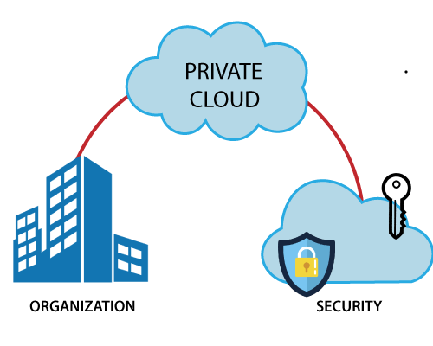
Private Cloud
Private cloud is also known as an internal cloud or corporate cloud. It is used by organizations to build and manage their own data centers internally or by the third party. It can be deployed using Opensource tools such as Openstack and Eucalyptus.
Based on the location and management, National Institute of Standards and Technology (NIST) divide private cloud into the following two parts-
On-premise private cloud
Outsourced private cloud

Slide 8
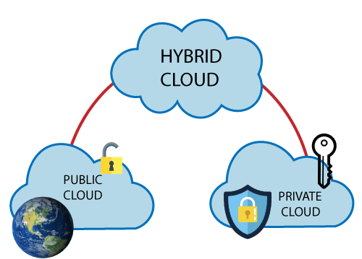
Hybrid Cloud
Hybrid Cloud is a combination of the public cloud and the private cloud. we can say:
Hybrid Cloud = Public Cloud + Private Cloud
Hybrid cloud is partially secure because the services which are running on the public cloud can be accessed by anyone, while the services which are running on a private cloud can be accessed only by the organization's users.
Example: Google Application Suite (Gmail, Google Apps, and Google Drive), Office 365 (MS Office on the Web and One Drive), Amazon Web Services.

Slide 9
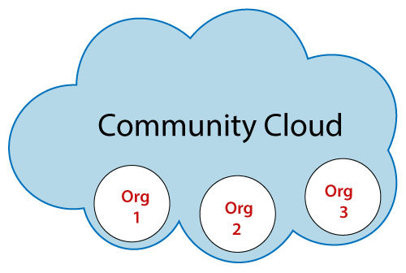
Community Cloud
Community cloud allows systems and services to be accessible by a group of several organizations to share the information between the organization and a specific community. It is owned, managed, and operated by one or more organizations in the community, a third party, or a combination of them.
Example: Health Care community cloud

Slide 10
Cloud Delivery Models

Slide 11
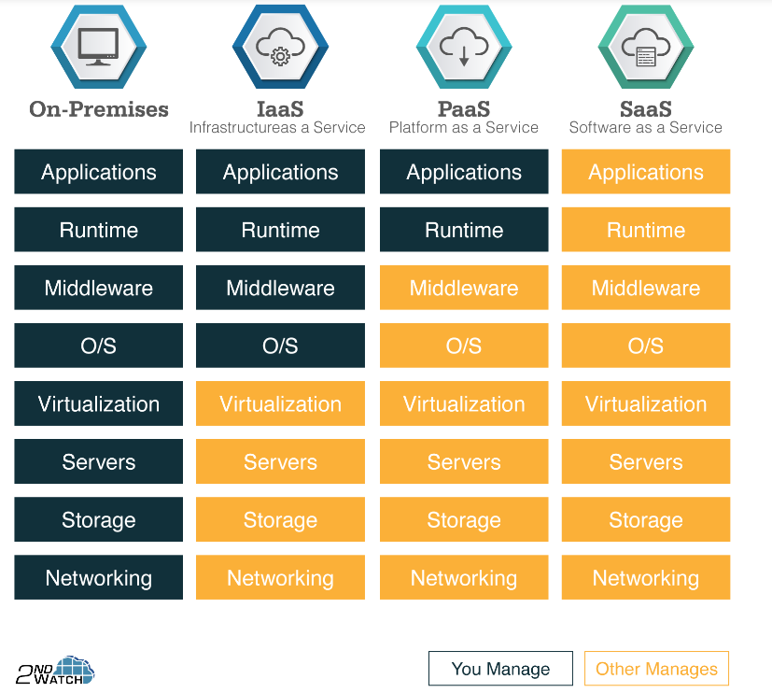
CSE

Slide 12


